Slide 1
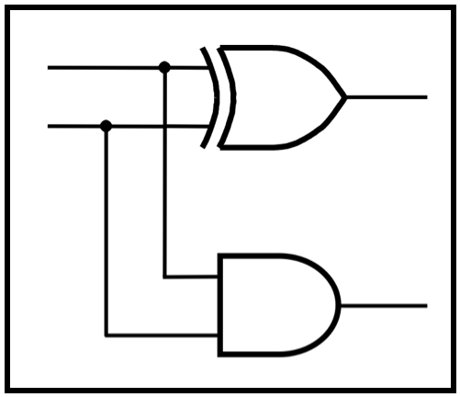
CprE 281:
Digital Logic
Instructor: Alexander Stoytchev
http://www.ece.iastate.edu/~alexs/classes/

Slide 2
Analysis of
Synchronous Sequential Circuits
CprE 281: Digital Logic
Iowa State University, Ames, IA
Copyright © Alexander Stoytchev

Slide 3
Administrative Stuff
Homework 11 is due on Nov 28

Slide 4
Administrative Stuff
Final Project (7% of your grade)
By now you should have selected a project
Also, posted on the class web page (Labs section)
This is your lab for the last two weeks
This is due during your last lab (dead week)

Slide 5
Administrative Stuff
Final Project: Stack Arithmetic problem
If you picked that one, then you can ignore the issues with arithmetic overflow and with negative numbers.
Simply assume that the test cases will not test for that.

Slide 6
Goal for Today's Lecture
Given a circuit diagram for a synchronous sequential circuit, the goal is to figure out the FSM
Figure out the present state variables, the next state variables, the state-assigned table, the state table, and finally the state diagram.
In other words, the goal is to reverse engineer the circuit.

Slide 7
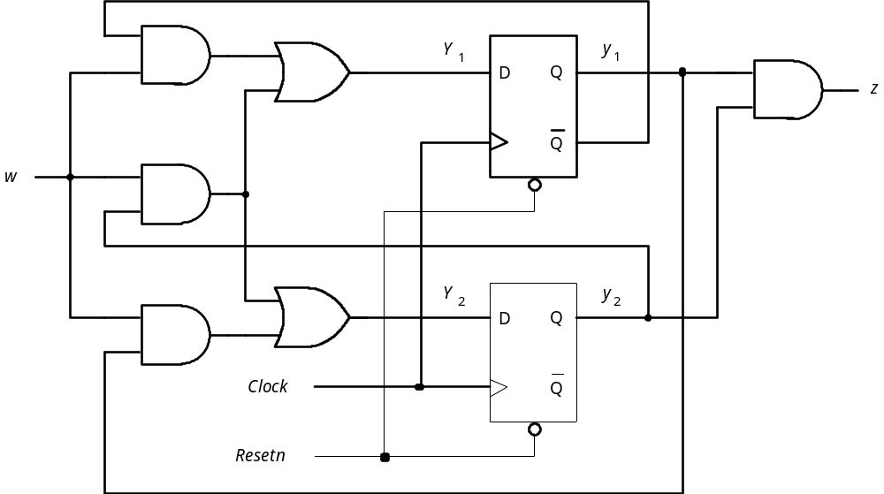
What does this circuit do?
[ Figure 6.75 from the textbook ]

Slide 8
Approach
Find the flip-flops
Outputs of the flip-flops = present state variables
Inputs of the flip-flops determine the next state variables
Determine the logical expressions for the outputs
Given this info it is easy to do the state-assigned table
Next do the state table
Finally, draw the state diagram.

Slide 9
Where are the inputs?
[ Figure 6.75 from the textbook ]

Slide 10
Where are the inputs?
There is
only one
input
[ Figure 6.75 from the textbook ]

Slide 11
Where are the outputs?
[ Figure 6.75 from the textbook ]

Slide 12
Where are the outputs?
There is
only one
output
[ Figure 6.75 from the textbook ]

Slide 13
Where kind of machine is this?
Moore or Mealy?
output
input

Slide 14
Moore: because the output does not depend directly on the primary input
output
input

Slide 15
Where are the memory elements?

Slide 16
Where are the memory elements?

Slide 17
Where are the outputs of the flip-flops?

Slide 18
Where are the outputs of the flip-flops?

Slide 19
These are the present-state variables

Slide 20
Where are the inputs of the flip-flops?

Slide 21
Where are the inputs of the flip-flops?

Slide 22
These are the next-state variables

Slide 23
What are their logic expressions?

Slide 24
What are their logic expressions?
Y₁ = wy₁ + wy₂
Y₂ = wy₁ + wy₂

Slide 25
Where is the output, again?

Slide 26
Where is the output, again?

Slide 27
What is its logic expression?

Slide 28
What is its logic expression?
z = y₁y₂

Slide 29
This is what we have to work with now
(we don’t need the circuit anymore)
Y₁ = wy₁ + wy₂
Y₂ = wy₁ + wy₂
z = y₁y₂

Slide 30
Let’s derive the state-assigned table
Y₁ = wy₁ + wy₂
Present
Next State
state
w
=
0
w
=
1
Output
y
2
y
1
z
Y₂ = wy₁ + wy₂
Y
Y
Y
Y
2
1
2
1
0
0
z = y₁y₂
0
1
1
0
1
1

Slide 31
Let’s derive the state-assigned table
Y₁ = wy₁ + wy₂
Present
Next State
state
w
=
0
w
=
1
Output
y
2
y
1
z
Y₂ = wy₁ + wy₂
Y
Y
Y
Y
2
1
2
1
0
0
z = y₁y₂
0
1
1
0
1
1

Slide 32
Let’s derive the state-assigned table
Y₁ = wy₁ + wy₂
Present
Next State
state
w
=
0
w
=
1
Output
y
2
y
1
z
Y₂ = wy₁ + wy₂
Y
Y
Y
Y
2
1
2
1
0
0
0
z = y₁y₂
0
1
0
1
0
0
1
1
1

Slide 33
Let’s derive the state-assigned table
Y₁ = wy₁ + wy₂
Present
Next State
state
w
=
0
w
=
1
Output
y
2
y
1
z
Y₂ = wy₁ + wy₂
Y
Y
Y
Y
2
1
2
1
0
0
0
z = y₁y₂
0
1
0
1
0
0
1
1
1

Slide 34
Let’s derive the state-assigned table
Y₁ = wy₁ + wy₂
Present
Next State
state
w
=
0
w
=
1
Output
y
2
y
1
z
Y₂ = wy₁ + wy₂
Y
Y
Y
Y
2
1
2
1
0
0
0
1
0
z = y₁y₂
0
1
0
0
0
1
0
0
1
0
1
1
0
1
1

Slide 35
Let’s derive the state-assigned table
Y₁ = wy₁ + wy₂
Present
Next State
state
w
=
0
w
=
1
Output
y
2
y
1
z
Y₂ = wy₁ + wy₂
Y
Y
Y
Y
2
1
2
1
0
0
0
1
0
z = y₁y₂
0
1
0
0
0
1
0
0
1
0
1
1
0
1
1

Slide 36
Let’s derive the state-assigned table
Y₁ = wy₁ + wy₂
Present
Next State
state
w
=
0
w
=
1
Output
y
2
y
1
z
Y₂ = wy₁ + wy₂
Y
Y
Y
Y
2
1
2
1
0
0
0
0
0 1
0
z = y₁y₂
0
1
0
0
1 0
0
1
0
0
0
1 1
0
1
1
0
0
1 1
1

Slide 37
We don’t need the logic expressions anymore
Y₁ = wy₁ + wy₂
Present
Next State
state
w
=
0
w
=
1
Output
y
2
y
1
z
Y₂ = wy₁ + wy₂
Y
Y
Y
Y
2
1
2
1
0
0
0
0
0 1
0
z = y₁y₂
0
1
0
0
1 0
0
1
0
0
0
1 1
0
1
1
0
0
1 1
1

Slide 38
We don’t need the logic expressions anymore
Present
Next State
state
w
=
0
w
=
1
Output
y
2
y
1
z
Y
Y
Y
Y
2
1
2
1
0
0
0
0
0 1
0
0
1
0
0
1 0
0
1
0
0
0
1 1
0
1
1
0
0
1 1
1

Slide 39
Let’s derive the state table
Present
Next state
Output
Present
Next State
state
w
=
0
w
=
1
z
state
w
=
0
w
=
1
Output
y
2
y
1
z
Y
Y
Y
Y
2
1
2
1
0
0
0
0
0 1
0
0
1
0
0
1 0
0
1
0
0
0
1 1
0
1
1
0
0
1 1
1
State table
State-assigned table

Slide 40
Let’s derive the state table
Present
Next state
Output
Present
Next State
state
w
=
0
w
=
1
z
state
w
=
0
w
=
1
Output
y
2
y
1
z
Y
Y
Y
Y
2
1
2
1
0
0
0
0
0 1
0
0
1
0
0
1 0
0
1
0
0
0
1 1
0
1
1
0
0
1 1
1
State table
State-assigned table

Slide 41
Let’s derive the state table
Present
Next state
Output
Present
Next State
state
w
=
0
w
=
1
z
state
w
=
0
w
=
1
Output
y
2
y
1
z
A
Y
Y
Y
Y
2
1
2
1
B
C
0
0
0
0
0 1
0
D
0
1
0
0
1 0
0
1
0
0
0
1 1
0
1
1
0
0
1 1
1
State table
State-assigned table

Slide 42
Let’s derive the state table
Present
Next state
Output
Present
Next State
state
w
=
0
w
=
1
z
state
w
=
0
w
=
1
Output
y
2
y
1
z
A
Y
Y
Y
Y
2
1
2
1
B
C
0
0
0
0
0 1
0
D
0
1
0
0
1 0
0
1
0
0
0
1 1
0
1
1
0
0
1 1
1
State table
State-assigned table

Slide 43
Let’s derive the state table
Present
Next state
Output
Present
Next State
state
w
=
0
w
=
1
z
state
w
=
0
w
=
1
Output
y
2
y
1
z
A
A
Y
Y
Y
Y
2
1
2
1
B
A
C
A
0
0
0
0
0 1
0
D
A
0
1
0
0
1 0
0
1
0
0
0
1 1
0
1
1
0
0
1 1
1
State table
State-assigned table

Slide 44
Let’s derive the state table
Present
Next state
Output
Present
Next State
state
w
=
0
w
=
1
z
state
w
=
0
w
=
1
Output
y
2
y
1
z
A
A
Y
Y
Y
Y
2
1
2
1
B
A
C
A
0
0
0
0
0 1
0
D
A
0
1
0
0
1 0
0
1
0
0
0
1 1
0
1
1
0
0
1 1
1
State table
State-assigned table

Slide 45
Let’s derive the state table
Present
Next state
Output
Present
Next State
state
w
=
0
w
=
1
z
state
w
=
0
w
=
1
Output
y
2
y
1
z
A
A
B
Y
Y
Y
Y
2
1
2
1
B
A
C
C
A
D
0
0
0
0
0 1
0
D
A
D
0
1
0
0
1 0
0
1
0
0
0
1 1
0
1
1
0
0
1 1
1
State table
State-assigned table

Slide 46
Let’s derive the state table
Present
Next state
Output
Present
Next State
state
w
=
0
w
=
1
z
state
w
=
0
w
=
1
Output
y
2
y
1
z
A
A
B
Y
Y
Y
Y
2
1
2
1
B
A
C
C
A
D
0
0
0
0
0 1
0
D
A
D
0
1
0
0
1 0
0
1
0
0
0
1 1
0
1
1
0
0
1 1
1
State table
State-assigned table

Slide 47
Let’s derive the state table
Present
Next state
Output
Present
Next State
state
w
=
0
w
=
1
z
state
w
=
0
w
=
1
Output
y
2
y
1
z
A
A
B
Y
Y
Y
Y
2
1
2
1
B
A
C
C
A
D
0
0
0
0
0 1
0
D
A
D
0
1
0
0
1 0
0
1
0
0
0
1 1
0
1
1
0
0
1 1
1
State table
State-assigned table
The output is the same in both tables

Slide 48
The two tables for the initial circuit
Present
Next state
Output
Present
Next State
state
w
=
0
w
=
1
z
state
w
=
0
w
=
1
Output
y
2
y
1
z
A
A
B
0
Y
Y
Y
Y
2
1
2
1
B
A
C
0
C
A
D
0
0
0
0
0
0 1
0
D
A
D
1
0
1
0
0
1 0
0
1
0
0
0
1 1
0
1
1
0
0
1 1
1
State table
State-assigned table
[ Figure 6.76 from the textbook ]

Slide 49
We don’t need the state-assigned table anymore
Present
Next state
Output
Present
Next State
state
w
=
0
w
=
1
z
state
w
=
0
w
=
1
Output
y
2
y
1
z
A
A
B
0
Y
Y
Y
Y
2
1
2
1
B
A
C
0
C
A
D
0
0
0
0
0
0 1
0
D
A
D
1
0
1
0
0
1 0
0
1
0
0
0
1 1
0
1
1
0
0
1 1
1
State table
State-assigned table
[ Figure 6.76 from the textbook ]

Slide 50
We don’t need the state-assigned table anymore
Present
Next state
Output
state
w
=
0
w
=
1
z
A
A
B
0
B
A
C
0
C
A
D
0
D
A
D
1
State table

Slide 51
Let’s Draw the State Diagram
Present
Next state
Output
state
w
=
0
w
=
1
z
A
A
B
0
B
A
C
0
C
A
D
0
D
A
D
1

Slide 52
Let’s Draw the State Diagram
A / 0
Present
Next state
Output
state
w
=
0
w
=
1
z
A
A
B
0
B / 0
B
A
C
0
C
A
D
0
D
A
D
1
C / 0
Because this is a Moore machine
the output is tied to the state
D / 1

Slide 53
Let’s Draw the State Diagram
A / 0
Present
Next state
Output
state
w
=
0
w
=
1
z
A
A
B
0
B / 0
B
A
C
0
C
A
D
0
D
A
D
1
C / 0
All transitions when the input w is equal to 1
D / 1

Slide 54
Let’s Draw the State Diagram
A / 0
Present
Next state
Output
state
z
w=1
w
=
0
w
=
1
A
A
B
0
B / 0
B
A
C
0
C
A
D
0
w=1
D
A
D
1
C / 0
All transitions when the input w is equal to 1
w=1
D / 1
w=1

Slide 55
Let’s Draw the State Diagram
A / 0
Present
Next state
Output
state
z
w=1
w
=
0
w
=
1
A
A
B
0
B / 0
B
A
C
0
C
A
D
0
w=1
D
A
D
1
C / 0
All transitions when the input w is equal to 0
w=1
D / 1
w=1

Slide 56
Let’s Draw the State Diagram
w=0
A / 0
Present
Next state
Output
state
z
w=1
w
=
0
w
=
1
A
A
B
0
B / 0
B
A
C
0
w=0
C
A
D
0
w=1
D
A
D
1
w=0
C / 0
All transitions when the input w is equal to 0
w=1
w=0
w=1
D / 1

Slide 57
We are done!
w=0
A / 0
Present
Next state
Output
state
z
w=1
w
=
0
w
=
1
A
A
B
0
B / 0
B
A
C
0
w=0
C
A
D
0
w=1
D
A
D
1
w=0
C / 0
State table
w=1
w=0
w=1
D / 1
State diagram

Slide 58
Almost done. What does this FSM do?
w=0
A / 0
Present
Next state
Output
state
z
w=1
w
=
0
w
=
1
A
A
B
0
B / 0
B
A
C
0
w=0
C
A
D
0
w=1
D
A
D
1
w=0
C / 0
State table
w=1
w=0
w=1
D / 1
State diagram

Slide 59
Almost done. What does this FSM do?
It sets the output z to 1 when
three consecutive 1’s occur on the input w.
In other words, it is a sequence detector
for the input pattern 111.
w=0
A / 0
Present
Next state
Output
state
z
w=1
w
=
0
w
=
1
A
A
B
0
B / 0
B
A
C
0
w=0
C
A
D
0
w=1
D
A
D
1
w=0
C / 0
State table
w=1
w=0
w=1
D / 1
State diagram

Slide 60
Another Example
(with JK flip-flops)

Slide 61
What does this circuit do?
J
y
1
w
1
J
Q
z
K
Q
K
1
J
2
y
2
J
Q
Clock
K
Q
K
2
Resetn
[ Figure 6.77 from the textbook ]

Slide 62
Approach
Find the flip-flops
Outputs of the flip-flops = present state variables
Inputs of the flip-flops determine the next state variables
Determine the logical expressions for the outputs
Given this info it is easy to do the state-assigned table
Next do the state table
Finally, draw the state diagram.

Slide 63
Where are the inputs and outputs?
J
y
1
w
1
J
Q
z
K
Q
K
1
J
2
y
2
J
Q
Clock
K
Q
K
2
Resetn
[ Figure 6.77 from the textbook ]

Slide 64
Where are the inputs and outputs?
J
y
1
w
1
J
Q
z
input
K
Q
output
K
1
J
2
y
2
J
Q
Clock
K
Q
K
2
Resetn

Slide 65
What kind of machine is this?
J
y
1
w
1
J
Q
z
input
K
Q
output
K
1
J
2
y
2
J
Q
Clock
K
Q
K
2
Resetn

Slide 66
Where are the flip-flops?
J
y
1
w
1
J
Q
z
K
Q
K
1
J
2
y
2
J
Q
Clock
K
Q
K
2
Resetn

Slide 67
Where are the flip-flops?
J
y
1
w
1
J
Q
z
K
Q
K
1
J
2
y
2
J
Q
Clock
K
Q
K
2
Resetn

Slide 68
Where are the outputs of the flip-flops?
J
y
1
w
1
J
Q
z
K
Q
K
1
J
2
y
2
J
Q
Clock
K
Q
K
2
Resetn

Slide 69
Where are the outputs of the flip-flops?
J
y
1
w
1
J
Q
z
K
Q
K
1
J
2
y
2
J
Q
Clock
K
Q
K
2
Resetn

Slide 70
These are the next-state variables
J
y
1
w
1
J
Q
z
K
Q
K
1
J
2
y
2
J
Q
Clock
K
Q
K
2
Resetn

Slide 71
Where are the inputs of the flip-flops?
J
y
1
w
1
J
Q
z
K
Q
K
1
J
2
y
2
J
Q
Clock
K
Q
K
2
Resetn

Slide 72
Where are the inputs of the flip-flops?
J
y
1
w
1
J
Q
z
K
Q
K
1
J
2
y
2
J
Q
Clock
K
Q
K
2
Resetn

Slide 73
What are their logic expressions?
J
y
1
w
1
J
Q
z
K
Q
K
1
J
2
y
2
J
Q
Clock
K
Q
K
2
Resetn

Slide 74
What are their logic expressions?
J₁ = w
J
y
1
w
1
J
Q
z
K
Q
K₁ = w + y₂
K
1
J₂ = w y₁
J
2
y
2
J
Q
Clock
K
Q
K
2
Resetn
K₂ = w

Slide 75
What is the logic expression of the output?
J
y
1
w
1
J
Q
z
K
Q
output
K
1
J
2
y
2
J
Q
Clock
K
Q
K
2
Resetn

Slide 76
What is the logic expression of the output?
z = y₁y₂
J
y
1
w
1
J
Q
z
K
Q
output
K
1
J
2
y
2
J
Q
Clock
K
Q
K
2
Resetn

Slide 77
This is what we have to work with now
(we don’t need the circuit anymore)
J₁ = w
K₁ = w + y₂
J₂ = w y₁
K₂ = w
z = y₁y₂

Slide 78
Let’s derive the excitation table
J₁ = w
K₁ = w + y₂
Present
Flip-flop inputs
state
w
=
0
w
=
1
Output
y
2
y
1
z
J
2
K
2
J
1
K
1
J
2
K
2
J
1
K
1
J₂ = w y₁
00
01
K₂ = w
10
11
z = y₁y₂

Slide 79
Let’s derive the excitation table
J₁ = w
K₁ = w + y₂
Present
Flip-flop inputs
state
w
=
0
w
=
1
Output
y
2
y
1
z
J
2
K
2
J
1
K
1
J
2
K
2
J
1
K
1
J₂ = w y₁
00
01
K₂ = w
10
11
z = y₁y₂

Slide 80
Let’s derive the excitation table
J₁ = w
K₁ = w + y₂
Present
Flip-flop inputs
state
w
=
0
w
=
1
Output
y
2
y
1
z
J
2
K
2
J
1
K
1
J
2
K
2
J
1
K
1
J₂ = w y₁
00
0
01
0
K₂ = w
10
0
11
1
z = y₁y₂

Slide 81
Let’s derive the excitation table
J₁ = w
K₁ = w + y₂
Present
Flip-flop inputs
state
w
=
0
w
=
1
Output
y
2
y
1
z
J
2
K
2
J
1
K
1
J
2
K
2
J
1
K
1
J₂ = w y₁
00
0
01
0
K₂ = w
10
0
11
1
z = y₁y₂

Slide 82
Let’s derive the excitation table
J₁ = w
K₁ = w + y₂
Present
Flip-flop inputs
state
w
=
0
w
=
1
Output
y
2
y
1
z
J
2
K
2
J
1
K
1
J
2
K
2
J
1
K
1
J₂ = w y₁
00
0
1
1
1
0
01
0
1
1
1
0
K₂ = w
10
0
1
1
0
0
11
0
1
1
0
1
z = y₁y₂

Slide 83
Let’s derive the excitation table
J₁ = w
K₁ = w + y₂
Present
Flip-flop inputs
state
w
=
0
w
=
1
Output
y
2
y
1
z
J
2
K
2
J
1
K
1
J
2
K
2
J
1
K
1
J₂ = w y₁
00
0
1
1
1
0
01
0
1
1
1
0
K₂ = w
10
0
1
1
0
0
11
0
1
1
0
1
z = y₁y₂

Slide 84
The excitation table
J₁ = w
K₁ = w + y₂
Present
Flip-flop inputs
state
w
=
0
w
=
1
Output
y
2
y
1
z
J
2
K
2
J
1
K
1
J
2
K
2
J
1
K
1
J₂ = w y₁
00
01
0
1
0
0
1
1
0
01
01
0
1
1
0
1
1
0
K₂ = w
10
01
0
1
0
0
1
0
0
11
01
0
1
1
0
1
0
1
z = y₁y₂
[ Figure 6.78 from the textbook ]

Slide 85
We don’t need the logic expressions anymore
J₁ = w
K₁ = w + y₂
Present
Flip-flop inputs
state
w
=
0
w
=
1
Output
y
2
y
1
z
J
2
K
2
J
1
K
1
J
2
K
2
J
1
K
1
J₂ = w y₁
00
01
0
1
0
0
1
1
0
01
01
0
1
1
0
1
1
0
K₂ = w
10
01
0
1
0
0
1
0
0
11
01
0
1
1
0
1
0
1
z = y₁y₂
[ Figure 6.78 from the textbook ]

Slide 86
We don’t need the logic expressions anymore
Present
Flip-flop inputs
state
w
=
0
w
=
1
Output
y
2
y
1
z
J
2
K
2
J
1
K
1
J
2
K
2
J
1
K
1
00
01
0
1
0
0
1
1
0
01
01
0
1
1
0
1
1
0
10
01
0
1
0
0
1
0
0
11
01
0
1
1
0
1
0
1
[ Figure 6.78 from the textbook ]

Slide 87
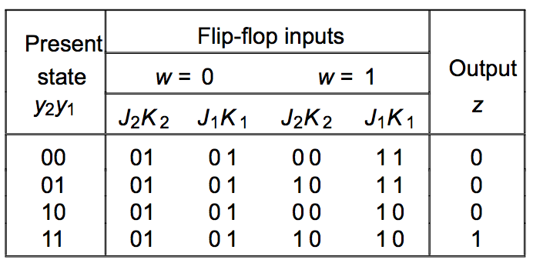
Let’s derive the state table
Present
Next state
Output
state
w
=
0
w
=
1
z
State table
Excitation table

Slide 88
Let’s derive the state table
Present
Next state
Output
state
w
=
0
w
=
1
z
A
B
C
D
State table
Excitation table
This step is easy
(map 2-bit numbers to 4 letters)

Slide 89
Let’s derive the state table
Present
Next state
Output
state
w
=
0
w
=
1
z
A
0
B
0
C
0
D
1
State table
Excitation table
This step is easy too
(the outputs are the same in both tables)

Slide 90
Let’s derive the state table
Present
Next state
Output
state
w
=
0
w
=
1
z
A
?
0
B
0
C
0
D
1
State table
Excitation table
How should we do this?

Slide 91
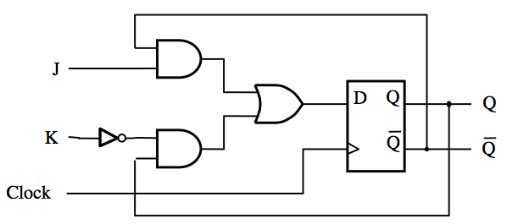
JK Flip-Flop Refresher
D = JQ + KQ
[ Figure 5.16a from the textbook ]

Slide 92
JK Flip-Flop Refresher
J
D
Q
Q
K
Q
Q
Clock
(a) Circuit
J
K
Q
(
t
+
1
)
0
0
Q
(
t
)
J
Q
0
1
0
1
0
1
K
Q
1
1
Q
(
t
)
(b) Truth table
(c) Graphical symbol
[ Figure 5.16 from the textbook ]

Slide 93
Let’s derive the state table
Present
Next state
Output
state
w
=
0
w
=
1
z
A
?
0
B
0
C
0
D
1
State table
Excitation table
How should we do this?

Slide 94
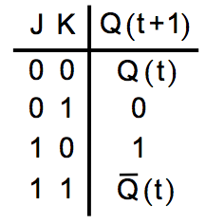
Let’s derive the state table
Present
Next state
Output
state
w
=
0
w
=
1
z
A
0
B
0
C
0
D
1

Slide 95
Let’s derive the state table
Present
Next state
Output
state
w
=
0
w
=
1
z
A
0
B
0
C
0
D
1

Slide 96
Let’s derive the state table
Present
Next state
Output
state
w
=
0
w
=
1
z
A
A
0
B
0
C
0
D
1
Note that A = 00

Slide 97
Let’s derive the state table
Present
Next state
Output
state
w
=
0
w
=
1
z
A
A
0
B
?
0
C
0
D
1

Slide 98
Let’s derive the state table
Present
Next state
Output
state
w
=
0
w
=
1
z
A
A
0
B
0
C
0
D
1

Slide 99
Let’s derive the state table
Present
Next state
Output
state
w
=
0
w
=
1
z
A
A
0
B
0
C
0
D
1

Slide 100
Let’s derive the state table
Present
Next state
Output
state
w
=
0
w
=
1
z
A
A
0
B
0
C
0
D
1

Slide 101
Let’s derive the state table
Present
Next state
Output
state
w
=
0
w
=
1
z
A
A
0
B
0
C
0
D
1
= 1 = 0

Slide 102
Let’s derive the state table
Present
Next state
Output
state
w
=
0
w
=
1
z
A
A
0
B
C
0
C
0
D
1
Note that C = 10
=0

Slide 103
The two tables for the initial circuit
Present
Next state
Output
state
w
=
0
w
=
1
z
A
A
B
0
B
A
C
0
C
A
D
0
D
A
D
1
State table
Excitation table

Slide 104
The state diagram
w=0
A / 0
Present
Next state
Output
w=1
state
w
=
0
w
=
1
z
A
A
B
0
w=0
B / 0
B
A
C
0
C
A
D
0
w=1
D
A
D
1
w=0
C / 0
State table
w=1
w=0
w=1
D / 1
State diagram

Slide 105
The state diagram
Thus, this FSM is identical to the one
in the previous example, even though
the circuit uses JK flip-flops.
w=0
A / 0
Present
Next state
Output
w=1
state
w
=
0
w
=
1
z
A
A
B
0
w=0
B / 0
B
A
C
0
C
A
D
0
w=1
D
A
D
1
w=0
C / 0
State table
w=1
w=0
w=1
D / 1
State diagram

Slide 106
Yet Another Example
(with mixed flip-flops)

Slide 107
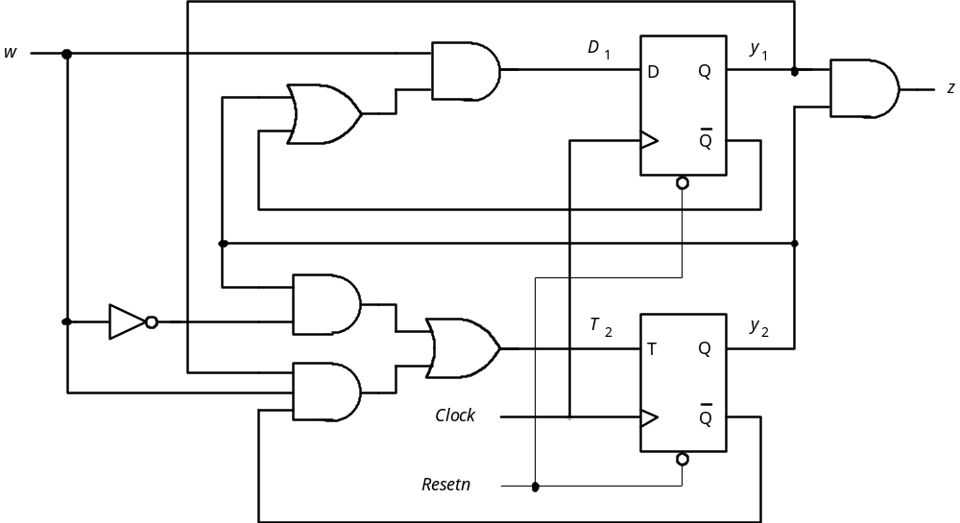
What does this circuit do?
[ Figure 6.79 from the textbook ]

Slide 108
Approach
Find the flip-flops
Outputs of the flip-flops = present state variables
Inputs of the flip-flops determine the next state variables
Determine the logical expressions for the outputs
Given this info it is easy to do the state-assigned table
Next do the state table
Finally, draw the state diagram.

Slide 109
What are the logic expressions?
[ Figure 6.79 from the textbook ]

Slide 110
What are the logic expressions?

Slide 111
What are the logic expressions?
D₁ = w (y₁ + y₂)
z = y₁y₂
T₂ = w y₂ + w y₁y₂

Slide 112
The Excitation Table
D₁ = w (y₁ + y₂)
Present
Flip-flop inputs
Output
state
w
=
0
w
=
1
y
y
z
2
1
T
D
T
D
T₂ = w y₂ + w y₁y₂
2
1
2
1
0
0
0
0
01
0
0
1
0
0
10
0
z = y₁y₂
1
0
1
0
01
0
1
1
1
0
01
1
Excitation table

Slide 113
Let’s derive the state table
Present
Flip-flop inputs
Next state
Output
Present
Output
state
w
=
0
w
=
1
state
w
=
0
w
=
1
z
y
y
z
2
1
T
D
T
D
2
1
2
1
0
0
0
0
01
0
0
1
0
0
10
0
1
0
1
0
01
0
1
1
1
0
01
1

Slide 114
Let’s derive the state table
Present
Flip-flop inputs
Next state
Output
Present
Output
state
w
=
0
w
=
1
state
w
=
0
w
=
1
z
y
y
z
2
1
T
D
T
D
2
1
2
1
A
B
0
0
0
0
01
0
C
0
1
0
0
10
0
D
1
0
1
0
01
0
1
1
1
0
01
1
This step is easy
(map 2-bit numbers to 4 letters)

Slide 115
Let’s derive the state table
Present
Flip-flop inputs
Next state
Output
Present
Output
state
w
=
0
w
=
1
state
w
=
0
w
=
1
z
y
y
z
2
1
T
D
T
D
2
1
2
1
A
0
B
0
0
0
0
0
01
0
C
0
0
1
0
0
10
0
D
1
1
0
1
0
01
0
1
1
1
0
01
1
This step is easy too
(the outputs are the same in both tables)

Slide 116
Let’s derive the state table
Present
Flip-flop inputs
Next state
Output
Present
Output
state
w
=
0
w
=
1
state
w
=
0
w
=
1
z
y
y
z
2
1
T
D
T
D
?
2
1
2
1
A
0
B
0
0
0
0
0
01
0
C
0
0
1
0
0
10
0
D
1
1
0
1
0
01
0
1
1
1
0
01
1
What should we do here?

Slide 117
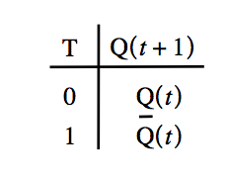
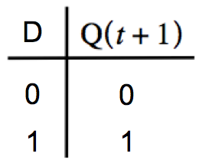
Let’s derive the state table
Present
Flip-flop inputs
Next state
Output
Present
Output
state
w
=
0
w
=
1
state
w
=
0
w
=
1
z
y
y
z
2
1
T
D
T
D
?
2
1
2
1
A
0
B
0
0
0
0
0
01
0
C
0
0
1
0
0
10
0
D
1
1
0
1
0
01
0
1
1
1
0
01
1
What should we do here?

Slide 118
Let’s derive the state table
Present
Flip-flop inputs
Next state
Output
Present
Output
state
w
=
0
w
=
1
state
w
=
0
w
=
1
z
y
y
z
2
1
T
D
T
D
2
1
2
1
A
0
B
0
0
0
0
0
01
0
C
0
0
1
0
0
10
0
D
1
1
0
1
0
01
0
1
1
1
0
01
1

Slide 119
Let’s derive the state table
Present
Flip-flop inputs
Next state
Output
Present
Output
state
w
=
0
w
=
1
state
w
=
0
w
=
1
z
y
y
z
2
1
T
D
T
D
2
1
2
1
A
0
B
0
0
0
0
0
01
0
C
0
0
1
0
0
10
0
D
1
1
0
1
0
01
0
1
1
1
0
01
1

Slide 120
Let’s derive the state table
Present
Flip-flop inputs
Next state
Output
Present
Output
state
w
=
0
w
=
1
state
w
=
0
w
=
1
z
y
y
z
2
1
T
D
T
D
2
1
2
1
A
0
B
0
0
0
0
0
01
0
C
0
0
1
0
0
10
0
D
1
1
0
1
0
01
0
1
1
1
0
01
1

Slide 121
Let’s derive the state table
Present
Flip-flop inputs
Next state
Output
Present
Output
state
w
=
0
w
=
1
state
w
=
0
w
=
1
z
y
y
z
2
1
T
D
T
D
2
1
2
1
A
0
B
0
0
0
0
0
01
0
C
0
0
1
0
0
10
0
D
1
1
0
1
0
01
0
1
1
1
0
01
1
0

Slide 122
Let’s derive the state table
Present
Flip-flop inputs
Next state
Output
Present
Output
state
w
=
0
w
=
1
state
w
=
0
w
=
1
z
y
y
z
2
1
T
D
T
D
2
1
2
1
A
0
B
0
0
0
0
0
01
0
C
0
0
1
0
0
10
0
D
1
1
0
1
0
01
0
1
1
1
0
01
1
0

Slide 123
Let’s derive the state table
Present
Flip-flop inputs
Next state
Output
Present
Output
state
w
=
0
w
=
1
state
w
=
0
w
=
1
z
y
y
z
2
1
T
D
T
D
2
1
2
1
A
0
B
0
0
0
0
0
01
0
C
0
0
1
0
0
10
0
D
1
1
0
1
0
01
0
1
1
1
0
01
1
0

Slide 124
Let’s derive the state table
Present
Flip-flop inputs
Next state
Output
Present
Output
state
w
=
0
w
=
1
state
w
=
0
w
=
1
z
y
y
z
2
1
T
D
T
D
2
1
2
1
A
A
0
B
0
0
0
0
0
01
0
C
0
0
1
0
0
10
0
D
1
1
0
1
0
01
0
1
1
1
0
01
1
Note that A = 00
0

Slide 125
Let’s derive the state table
Present
Flip-flop inputs
Next state
Output
Present
Output
state
w
=
0
w
=
1
state
w
=
0
w
=
1
z
y
y
z
2
1
T
D
T
D
2
1
2
1
A
A
0
B
0
0
0
0
0
01
0
C
?
0
0
1
0
0
10
0
D
1
1
0
1
0
01
0
1
1
1
0
01
1
What should we do here?

Slide 126
Let’s derive the state table
Present
Flip-flop inputs
Next state
Output
Present
Output
state
w
=
0
w
=
1
state
w
=
0
w
=
1
z
y
y
z
2
1
T
D
T
D
2
1
2
1
A
A
0
B
0
0
0
0
0
01
0
C
0
0
1
0
0
10
0
D
1
1
0
1
0
01
0
1
1
1
0
01
1

Slide 127
Let’s derive the state table
Present
Flip-flop inputs
Next state
Output
Present
Output
state
w
=
0
w
=
1
state
w
=
0
w
=
1
z
y
y
z
2
1
T
D
T
D
2
1
2
1
A
A
0
B
0
0
0
0
0
01
0
C
0
0
1
0
0
10
0
D
1
1
0
1
0
01
0
1
1
1
0
01
1

Slide 128
Let’s derive the state table
Present
Flip-flop inputs
Next state
Output
Present
Output
state
w
=
0
w
=
1
state
w
=
0
w
=
1
z
y
y
z
2
1
T
D
T
D
2
1
2
1
A
A
0
B
0
0
0
0
0
01
0
C
0
0
1
0
0
10
0
D
1
1
0
1
0
01
0
1
1
1
0
01
1

Slide 129
Let’s derive the state table
Present
Flip-flop inputs
Next state
Output
Present
Output
state
w
=
0
w
=
1
state
w
=
0
w
=
1
z
y
y
z
2
1
T
D
T
D
2
1
2
1
A
A
0
B
0
0
0
0
0
01
0
C
0
0
1
0
0
10
0
D
1
1
0
1
0
01
0
1
1
1
0
01
1
1

Slide 130
Let’s derive the state table
Present
Flip-flop inputs
Next state
Output
Present
Output
state
w
=
0
w
=
1
state
w
=
0
w
=
1
z
y
y
z
2
1
T
D
T
D
2
1
2
1
A
A
0
B
0
0
0
0
0
01
0
C
0
0
1
0
0
10
0
D
1
1
0
1
0
01
0
1
1
1
0
01
1
1

Slide 131
Let’s derive the state table
Present
Flip-flop inputs
Next state
Output
Present
Output
state
w
=
0
w
=
1
state
w
=
0
w
=
1
z
y
y
z
2
1
T
D
T
D
2
1
2
1
A
A
0
B
0
0
0
0
0
01
0
C
0
0
1
0
0
10
0
D
1
1
0
1
0
01
0
1
1
1
0
01
1
1

Slide 132
Let’s derive the state table
Present
Flip-flop inputs
Next state
Output
Present
Output
state
w
=
0
w
=
1
state
w
=
0
w
=
1
z
y
y
z
2
1
T
D
T
D
2
1
2
1
A
A
0
B
0
0
0
0
0
01
0
C
D
0
0
1
0
0
10
0
D
1
1
0
1
0
01
0
1
1
1
0
01
1
Note that D = 11
1

Slide 133
Let’s derive the state table
Present
Flip-flop inputs
Next state
Output
Present
Output
state
w
=
0
w
=
1
state
w
=
0
w
=
1
z
y
y
z
2
1
T
D
T
D
2
1
2
1
A
A
B
0
B
A
C
0
0
0
0
0
01
0
C
A
D
0
0
1
0
0
10
0
D
A
D
1
1
0
1
0
01
0
1
1
1
0
01
1

Slide 134
The two tables for the initial circuit
Present
Flip-flop inputs
Next state
Output
Present
Output
state
w
=
0
w
=
1
state
w
=
0
w
=
1
z
y
y
z
2
1
T
D
T
D
2
1
2
1
A
A
B
0
B
A
C
0
0
0
0
0
01
0
C
A
D
0
0
1
0
0
10
0
D
A
D
1
1
0
1
0
01
0
1
1
1
0
01
1
State table
Excitation table
[ Figure 6.75b from the textbook ]
[ Figure 6.80 from the textbook ]

Slide 135
The state diagram
w=0
A / 0
Present
Next state
Output
w=1
state
w
=
0
w
=
1
z
A
A
B
0
w=0
B / 0
B
A
C
0
C
A
D
0
w=1
D
A
D
1
w=0
C / 0
State table
w=1
w=0
w=1
D / 1
State diagram

Slide 136
The state diagram
Thus, this FSM is identical to the ones
in the previous examples, even though
the circuit uses one D and one T flip-flop.
w=0
A / 0
Present
Next state
Output
w=1
state
w
=
0
w
=
1
z
A
A
B
0
w=0
B / 0
B
A
C
0
C
A
D
0
w=1
D
A
D
1
w=0
C / 0
State table
w=1
w=0
w=1
D / 1
State diagram

Slide 137
Questions?

Slide 138
THE END

